Slide 1

Petco Project Case Study
Yating Zhou(MSBA 2021)
Chen Li (MSBA 2021)

Slide 2
Contents
01
02
03
04
Objective &
Assumption
Exploratory Data Analysis
Methodology & Analysis
Conclusions & Insights

Slide 3
Objective
Assumption
Create a more accurate forecasting model to complement existing ones, predicting weekly or daily sales and margin (next 12 months) for each B&M store based on given data;
Pet Care Centers
Pet Services (Grooming, Dog training & Vaccinations)
The demand of customers changes over time
Covid-19 has impacts on sales and margin
The location of stores has impact on its revenue and margin

Slide 4
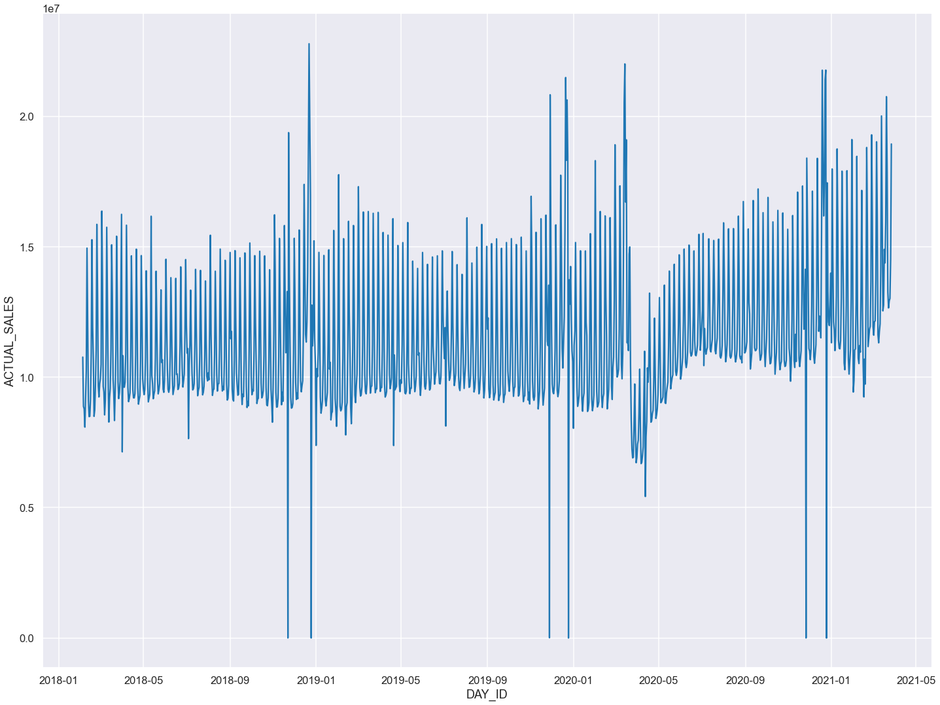
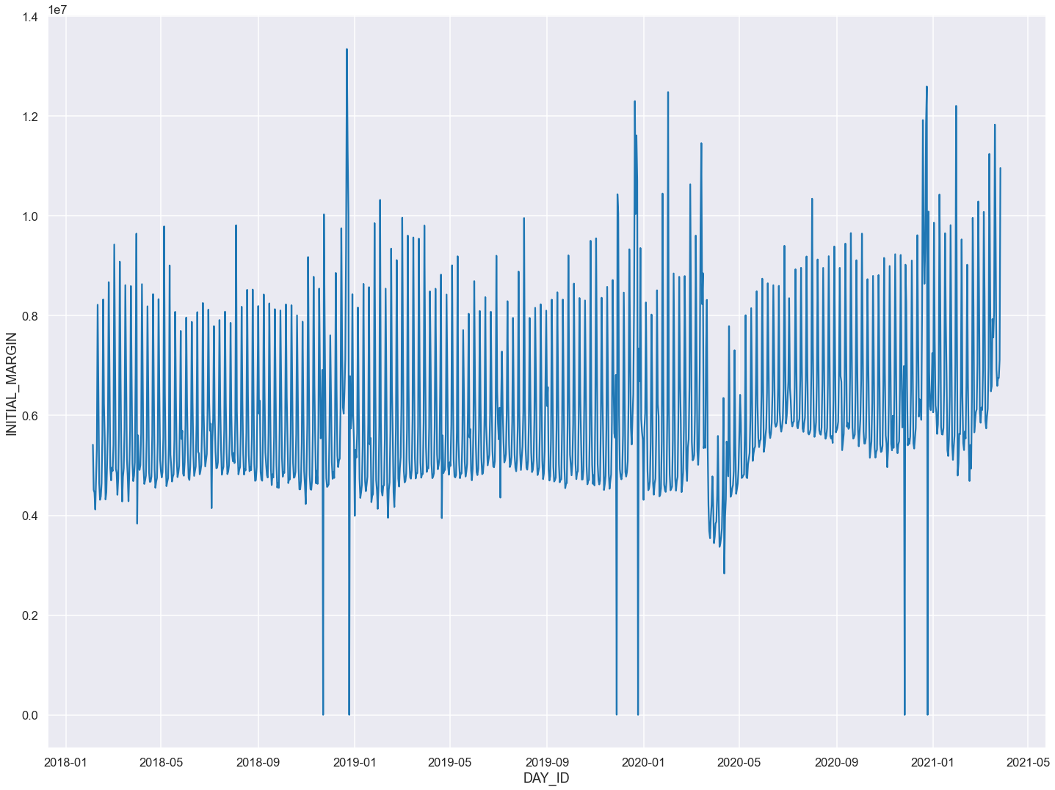
Exploratory Data Analysis
Actual Sales
Initial Margin
Author (Year). Title of the publication. Publisher
Author (Year). Title of the publication. Publisher
Author (Year). Title of the publication. Publisher
Author (Year). Title of the publication. Publisher
Author (Year). Title of the publication. Publisher
Author (Year). Title of the publication. Publisher
Author (Year). Title of the publication. Publisher
Author (Year). Title of the publication. Publisher

Slide 5
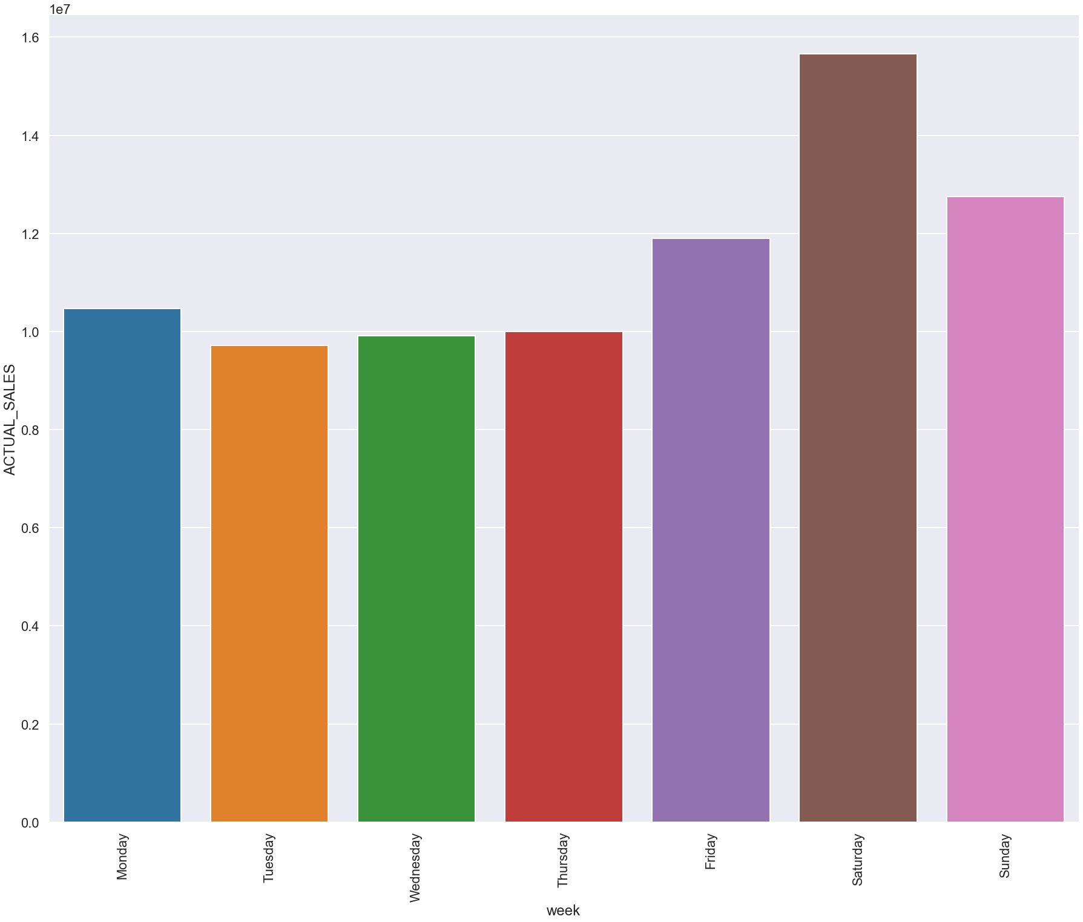
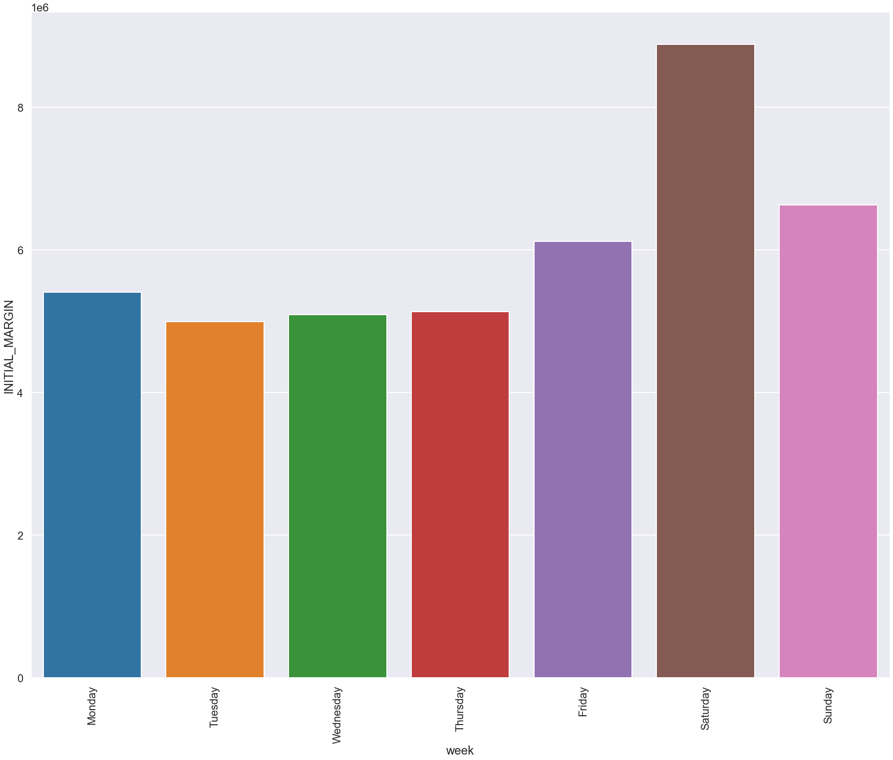
Exploratory Data Analysis
Actual Sales
Initial Margin
Author (Year). Title of the publication. Publisher
Author (Year). Title of the publication. Publisher
Author (Year). Title of the publication. Publisher
Author (Year). Title of the publication. Publisher
Author (Year). Title of the publication. Publisher
Author (Year). Title of the publication. Publisher
Author (Year). Title of the publication. Publisher
Author (Year). Title of the publication. Publisher

Slide 6
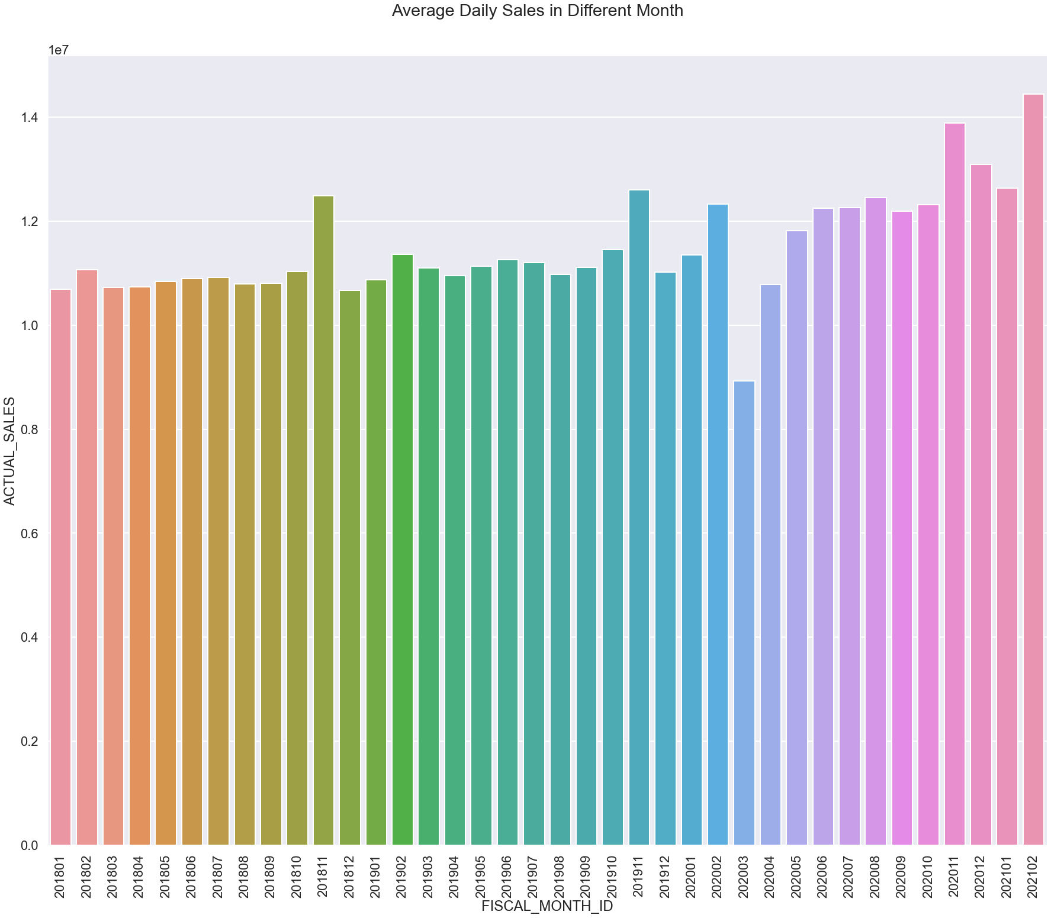
Exploratory Data Analysis
Author (Year). Title of the publication. Publisher
Author (Year). Title of the publication. Publisher
Author (Year). Title of the publication. Publisher
Author (Year). Title of the publication. Publisher
Author (Year). Title of the publication. Publisher
Author (Year). Title of the publication. Publisher
Author (Year). Title of the publication. Publisher
Author (Year). Title of the publication. Publisher

Slide 7
Model 1. Time-Series Decomposition + ARIMA
Model 2.
Prophet
Identify and interpret additive decompositions
Decompose a time series
Apply a lowess smoother
Apply a moving averages smoother
Apply a single exponential smoother
A Facebook open-source tool for forecasting time series data
Additive modeling non-linear trends
Considering seasonality (yearly, weekly and daily) and holiday effects

Slide 8
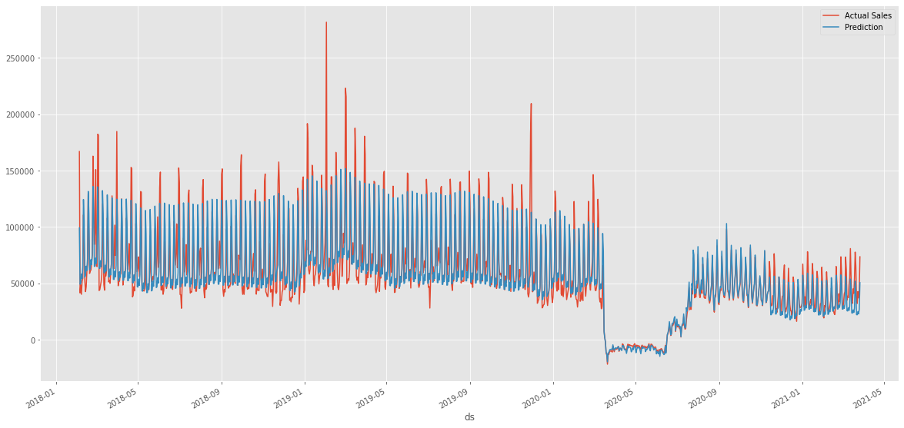
Pet Services: Dog Training
Prophet Model Performance on Daily Revenue
(AVG sales: $57911.29; RMSE on testing set : 11516.70)
Author (Year). Title of the publication. Publisher
Author (Year). Title of the publication. Publisher
Author (Year). Title of the publication. Publisher
Author (Year). Title of the publication. Publisher
Author (Year). Title of the publication. Publisher
Author (Year). Title of the publication. Publisher
Author (Year). Title of the publication. Publisher
Author (Year). Title of the publication. Publisher
test

Slide 9
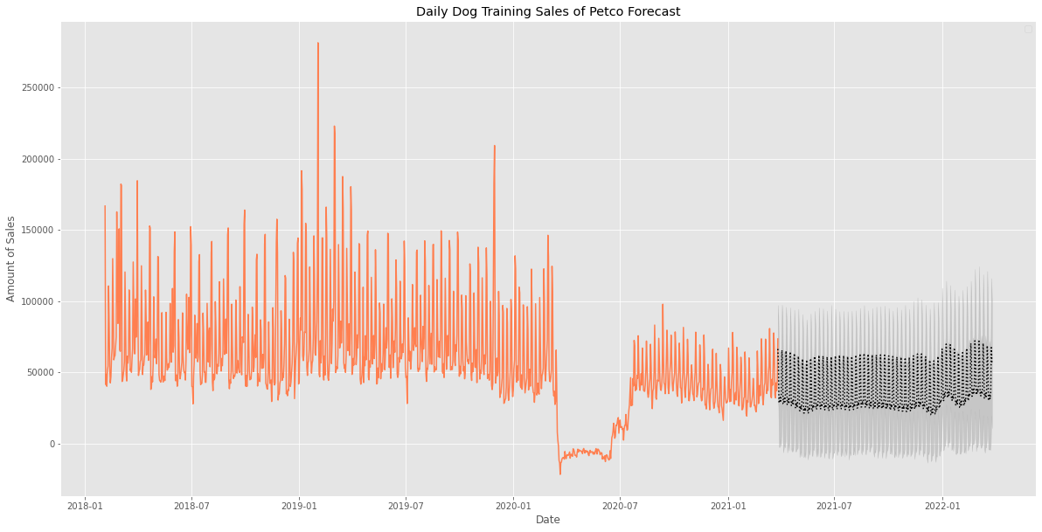
Pet Services: Dog Training
Prophet Model Prediction on Daily Revenue
Author (Year). Title of the publication. Publisher
Author (Year). Title of the publication. Publisher
Author (Year). Title of the publication. Publisher
Author (Year). Title of the publication. Publisher
Author (Year). Title of the publication. Publisher
Author (Year). Title of the publication. Publisher
Author (Year). Title of the publication. Publisher
Author (Year). Title of the publication. Publisher

Slide 10
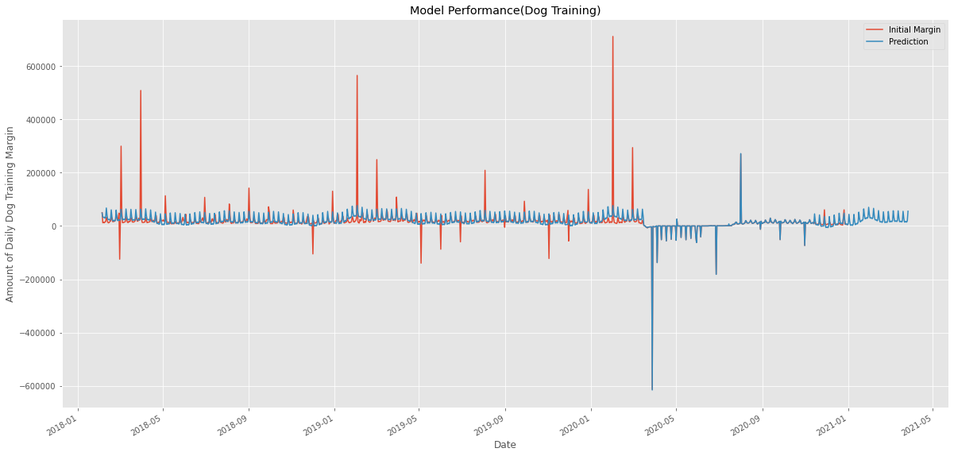
Pet Services: Dog Training
Prophet Model Performance on Daily Margin
(AVG margin: $19248; RMSE on testing set 154196.61)
Author (Year). Title of the publication. Publisher
Author (Year). Title of the publication. Publisher
Author (Year). Title of the publication. Publisher
Author (Year). Title of the publication. Publisher
Author (Year). Title of the publication. Publisher
Author (Year). Title of the publication. Publisher
Author (Year). Title of the publication. Publisher
Author (Year). Title of the publication. Publisher
test

Slide 11
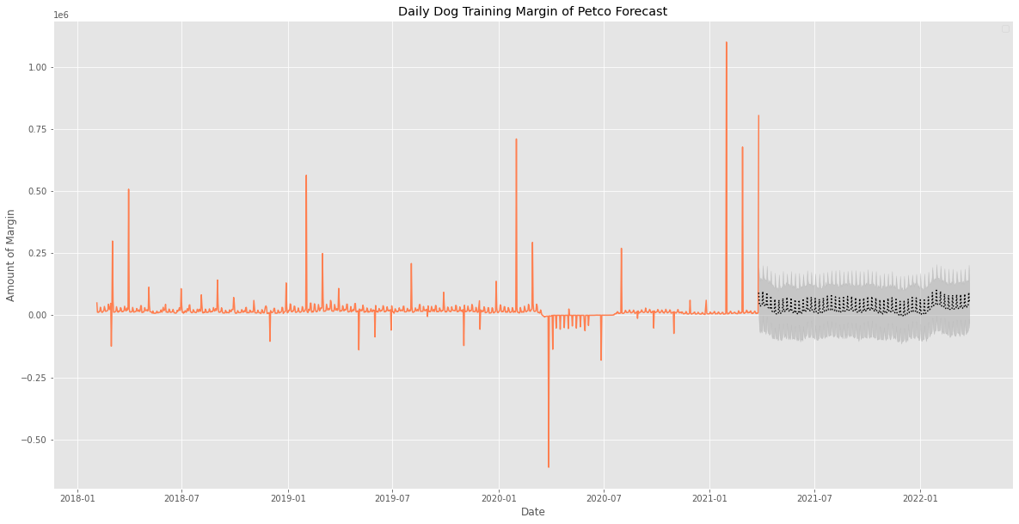
Pet Services: Dog Training
Prophet Model Prediction on Daily Margin
Author (Year). Title of the publication. Publisher
Author (Year). Title of the publication. Publisher
Author (Year). Title of the publication. Publisher
Author (Year). Title of the publication. Publisher
Author (Year). Title of the publication. Publisher
Author (Year). Title of the publication. Publisher
Author (Year). Title of the publication. Publisher
Author (Year). Title of the publication. Publisher

Slide 12
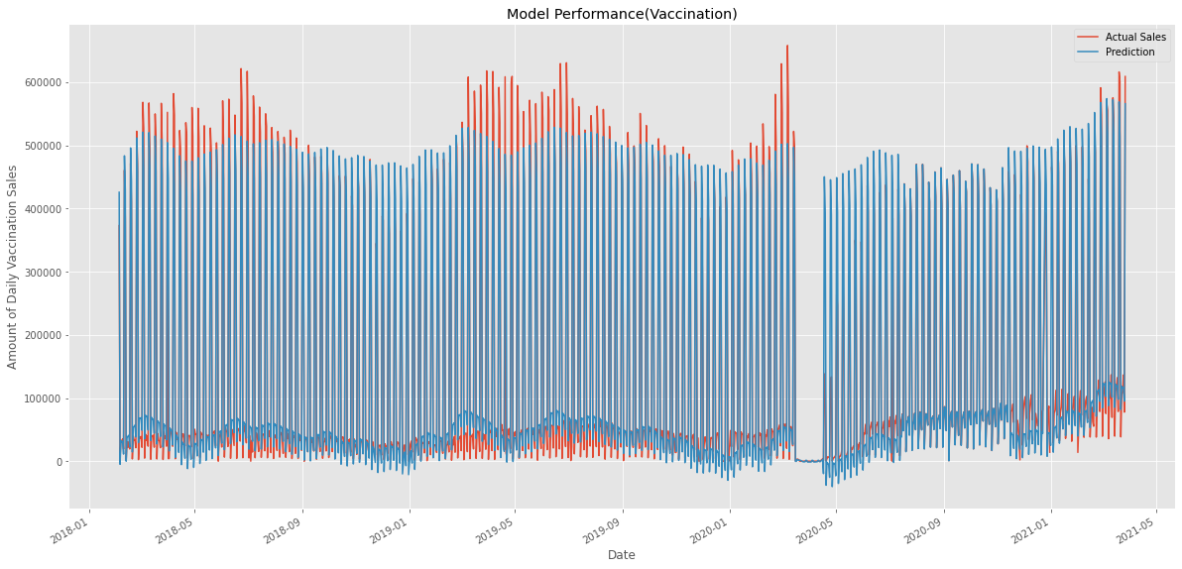
Pet Services: Vaccinations
Prophet Model Performance on Daily Revenue
(AVG sales: $157160.29; RMSE on testing set : 30202.29)
Author (Year). Title of the publication. Publisher
Author (Year). Title of the publication. Publisher
Author (Year). Title of the publication. Publisher
Author (Year). Title of the publication. Publisher
Author (Year). Title of the publication. Publisher
Author (Year). Title of the publication. Publisher
Author (Year). Title of the publication. Publisher
Author (Year). Title of the publication. Publisher
test

Slide 13
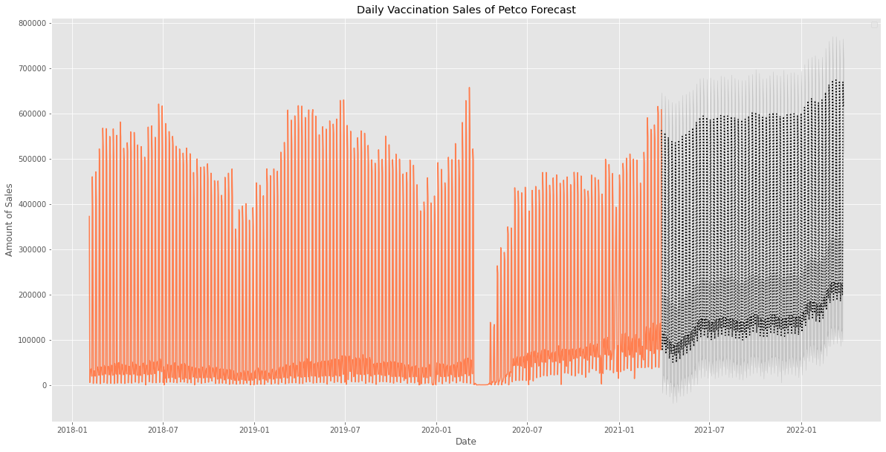
Pet Services: Vaccinations
Prophet Model Prediction on Daily Revenue
Author (Year). Title of the publication. Publisher
Author (Year). Title of the publication. Publisher
Author (Year). Title of the publication. Publisher
Author (Year). Title of the publication. Publisher
Author (Year). Title of the publication. Publisher
Author (Year). Title of the publication. Publisher
Author (Year). Title of the publication. Publisher
Author (Year). Title of the publication. Publisher

Slide 14
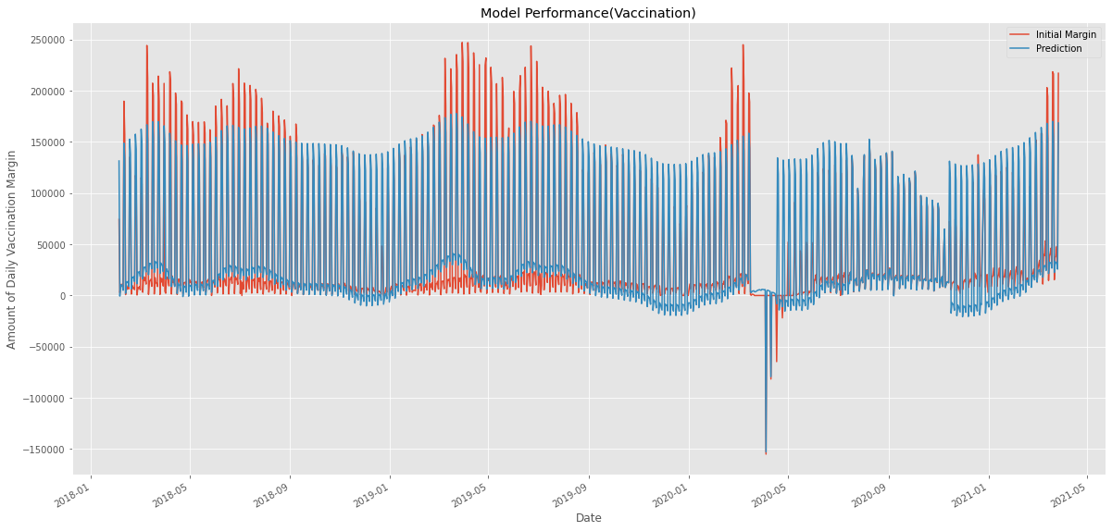
Pet Services: Vaccinations
Prophet Model Performance on Daily Margin
(AVG margin: $46571.15; RMSE on testing set : 21052.01)
Author (Year). Title of the publication. Publisher
Author (Year). Title of the publication. Publisher
Author (Year). Title of the publication. Publisher
Author (Year). Title of the publication. Publisher
Author (Year). Title of the publication. Publisher
Author (Year). Title of the publication. Publisher
Author (Year). Title of the publication. Publisher
Author (Year). Title of the publication. Publisher
test

Slide 15
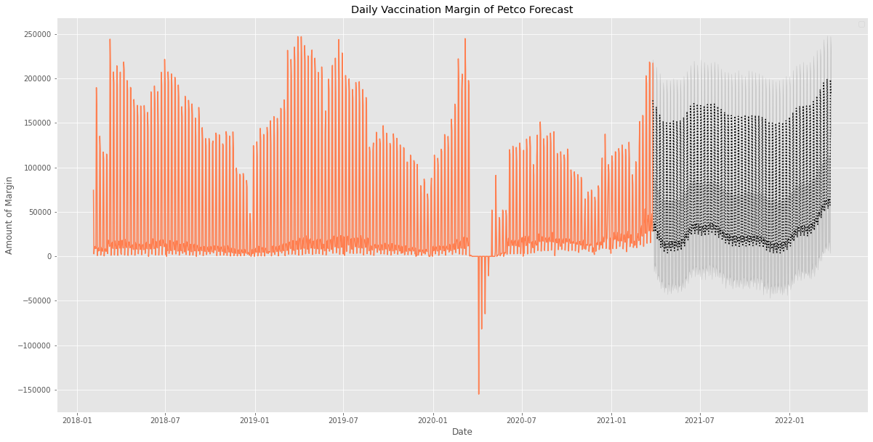
Pet Services: Vaccinations
Prophet Model Prediction on Daily Margin
Author (Year). Title of the publication. Publisher
Author (Year). Title of the publication. Publisher
Author (Year). Title of the publication. Publisher
Author (Year). Title of the publication. Publisher
Author (Year). Title of the publication. Publisher
Author (Year). Title of the publication. Publisher
Author (Year). Title of the publication. Publisher
Author (Year). Title of the publication. Publisher

Slide 16
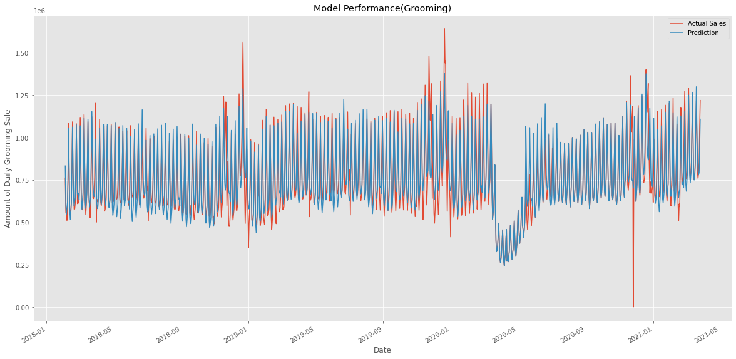
Pet Services: Grooming
Prophet Model Performance on Daily Revenue
(AVG sales: $761181; RMSE on testing set : 78425.71)
Author (Year). Title of the publication. Publisher
Author (Year). Title of the publication. Publisher
Author (Year). Title of the publication. Publisher
Author (Year). Title of the publication. Publisher
Author (Year). Title of the publication. Publisher
Author (Year). Title of the publication. Publisher
Author (Year). Title of the publication. Publisher
Author (Year). Title of the publication. Publisher
test

Slide 17
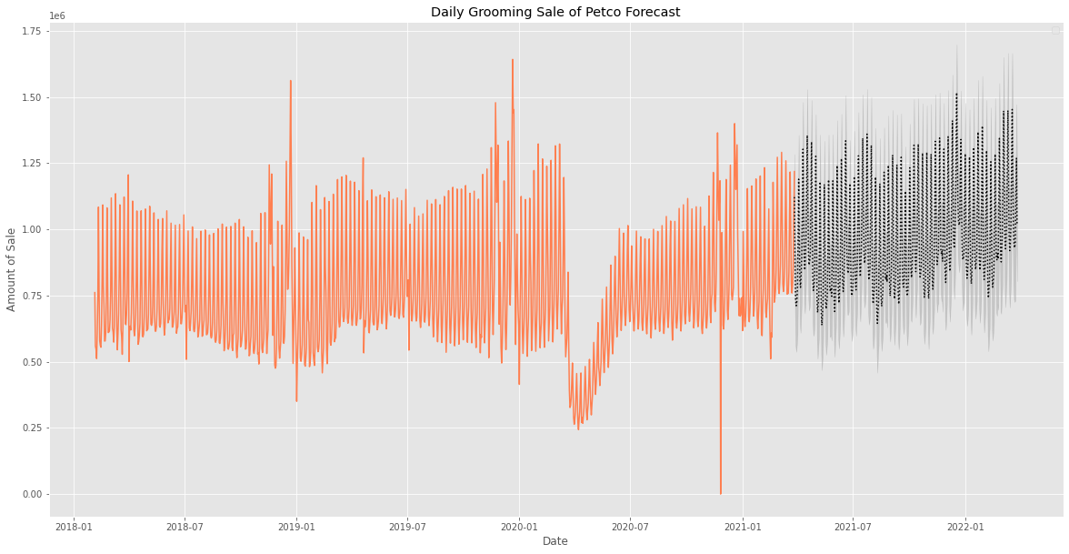
Pet Services: Grooming
Prophet Model Prediction on Daily Revenue
Author (Year). Title of the publication. Publisher
Author (Year). Title of the publication. Publisher
Author (Year). Title of the publication. Publisher
Author (Year). Title of the publication. Publisher
Author (Year). Title of the publication. Publisher
Author (Year). Title of the publication. Publisher
Author (Year). Title of the publication. Publisher
Author (Year). Title of the publication. Publisher

Slide 18
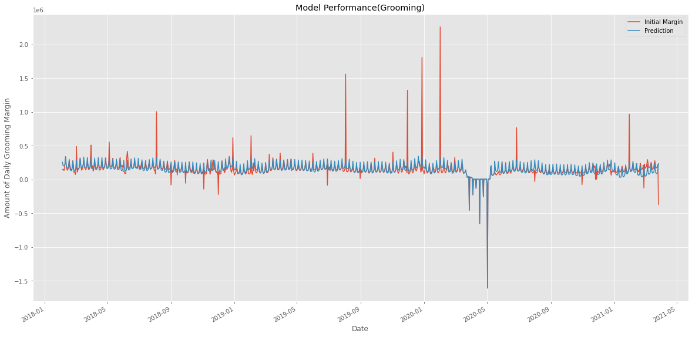
Pet Services: Grooming
Prophet Model Performance on Daily Margin
(AVG margin: $155841.05; RMSE on testing set : 127530.29)
Author (Year). Title of the publication. Publisher
Author (Year). Title of the publication. Publisher
Author (Year). Title of the publication. Publisher
Author (Year). Title of the publication. Publisher
Author (Year). Title of the publication. Publisher
Author (Year). Title of the publication. Publisher
Author (Year). Title of the publication. Publisher
Author (Year). Title of the publication. Publisher
test

Slide 19
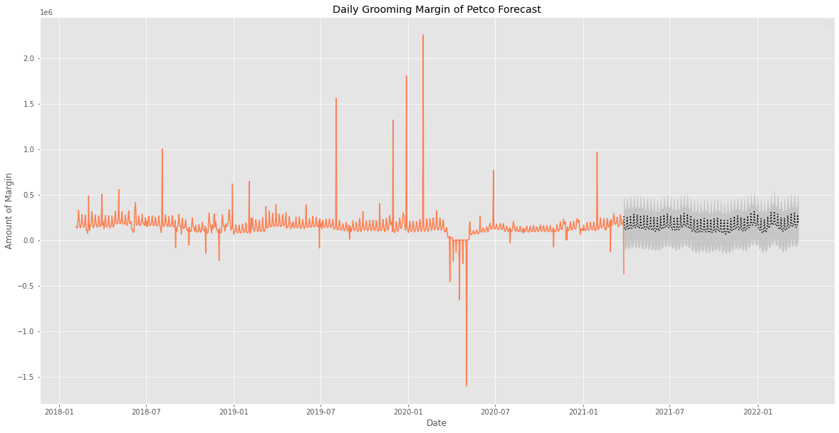
Pet Services: Grooming
Prophet Model Prediction on Daily Margin
Author (Year). Title of the publication. Publisher
Author (Year). Title of the publication. Publisher
Author (Year). Title of the publication. Publisher
Author (Year). Title of the publication. Publisher
Author (Year). Title of the publication. Publisher
Author (Year). Title of the publication. Publisher
Author (Year). Title of the publication. Publisher
Author (Year). Title of the publication. Publisher

Slide 20
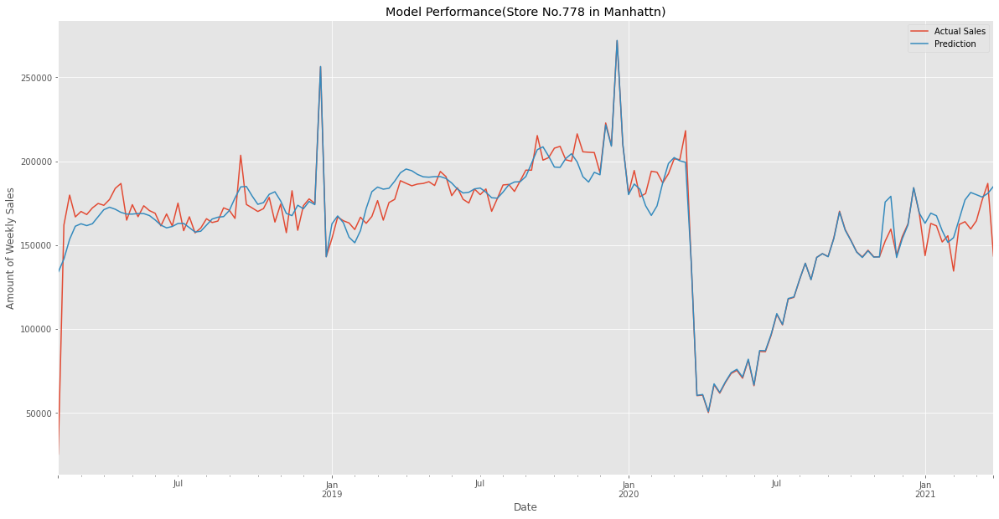
Pet Care Centers : Store778
Prophet Model Performance on Weekly Revenue
(AVG sales: $163616.98; RMSE on testing set : 12389.53)
Author (Year). Title of the publication. Publisher
Author (Year). Title of the publication. Publisher
Author (Year). Title of the publication. Publisher
Author (Year). Title of the publication. Publisher
Author (Year). Title of the publication. Publisher
Author (Year). Title of the publication. Publisher
Author (Year). Title of the publication. Publisher
Author (Year). Title of the publication. Publisher
test

Slide 21
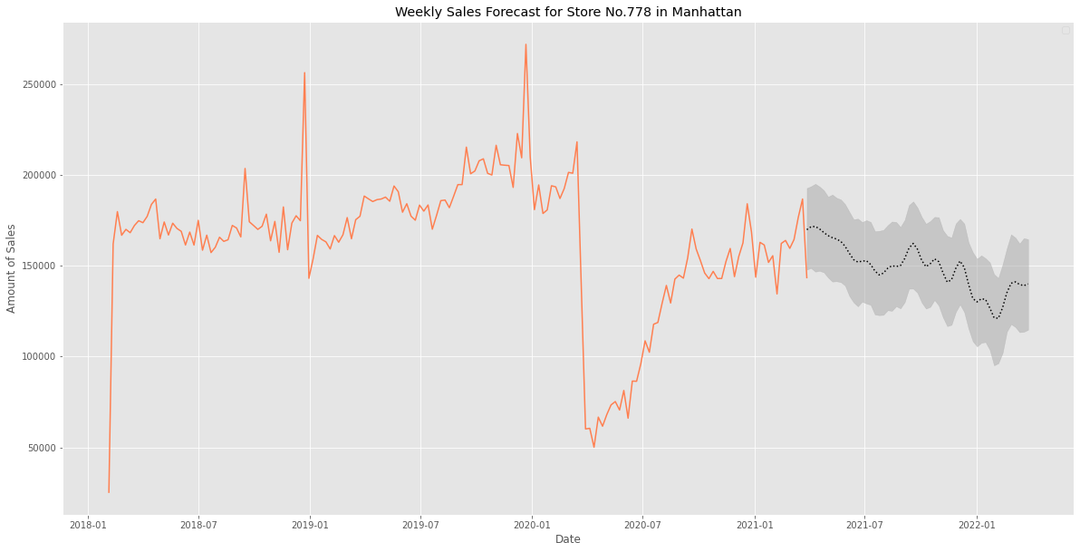
Pet Care Centers : Store778
Prophet Model Prediction on Weekly Revenue
Author (Year). Title of the publication. Publisher
Author (Year). Title of the publication. Publisher
Author (Year). Title of the publication. Publisher
Author (Year). Title of the publication. Publisher
Author (Year). Title of the publication. Publisher
Author (Year). Title of the publication. Publisher
Author (Year). Title of the publication. Publisher
Author (Year). Title of the publication. Publisher

Slide 22
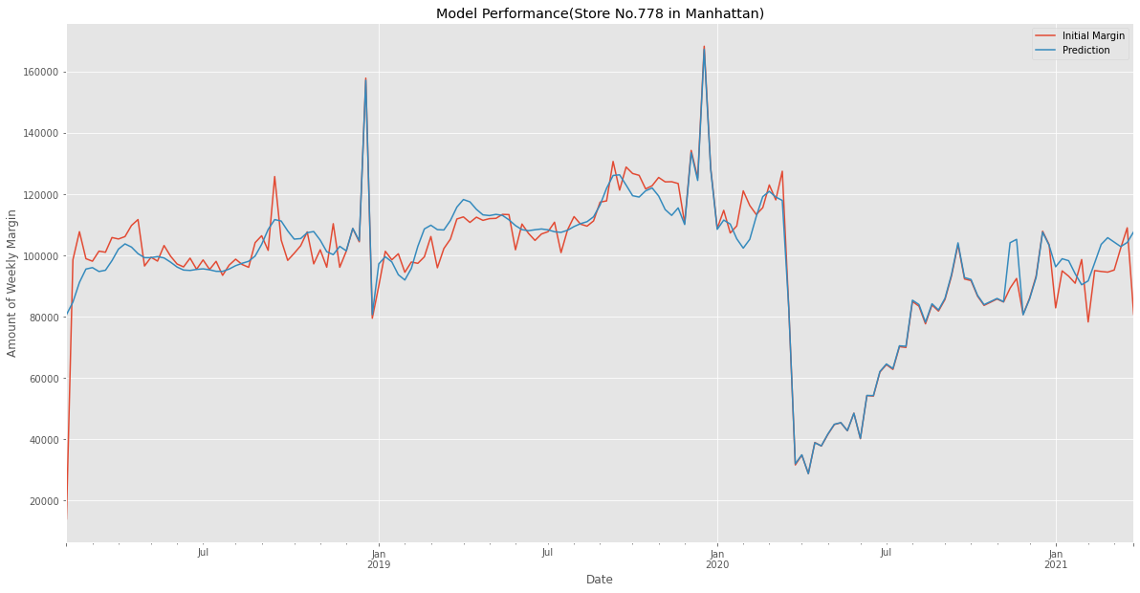
Pet Care Centers : Store778
Prophet Model Performance on Weekly Margin
(AVG margin: $97587.76; RMSE on testing set : 8141.00)
Author (Year). Title of the publication. Publisher
Author (Year). Title of the publication. Publisher
Author (Year). Title of the publication. Publisher
Author (Year). Title of the publication. Publisher
Author (Year). Title of the publication. Publisher
Author (Year). Title of the publication. Publisher
Author (Year). Title of the publication. Publisher
Author (Year). Title of the publication. Publisher
test

Slide 23
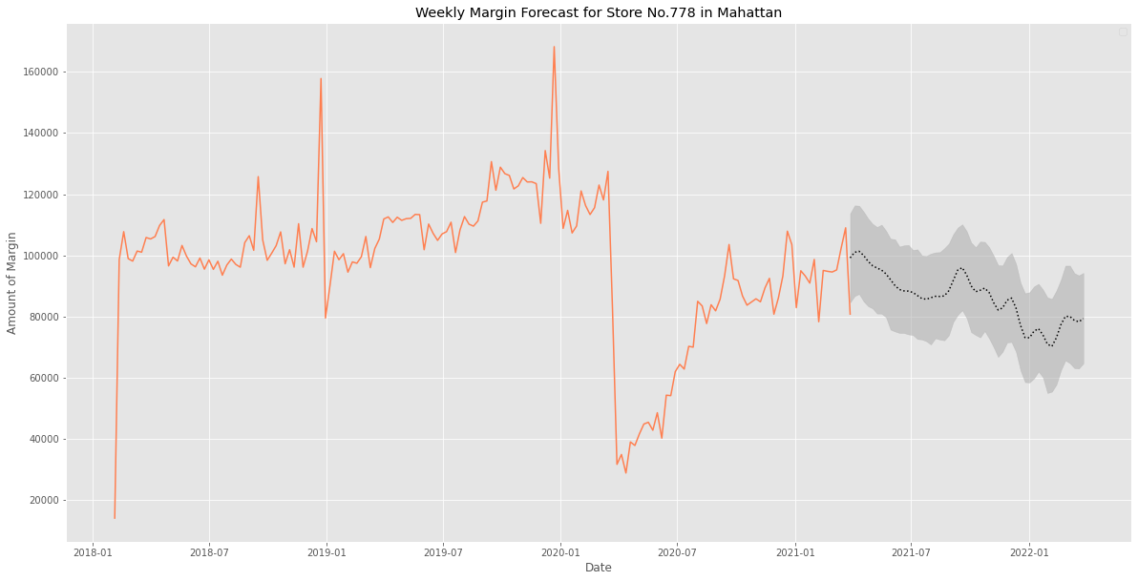
Pet Care Centers : Store778
Prophet Model Prediction on Weekly Margin
Author (Year). Title of the publication. Publisher
Author (Year). Title of the publication. Publisher
Author (Year). Title of the publication. Publisher
Author (Year). Title of the publication. Publisher
Author (Year). Title of the publication. Publisher
Author (Year). Title of the publication. Publisher
Author (Year). Title of the publication. Publisher
Author (Year). Title of the publication. Publisher

Slide 24
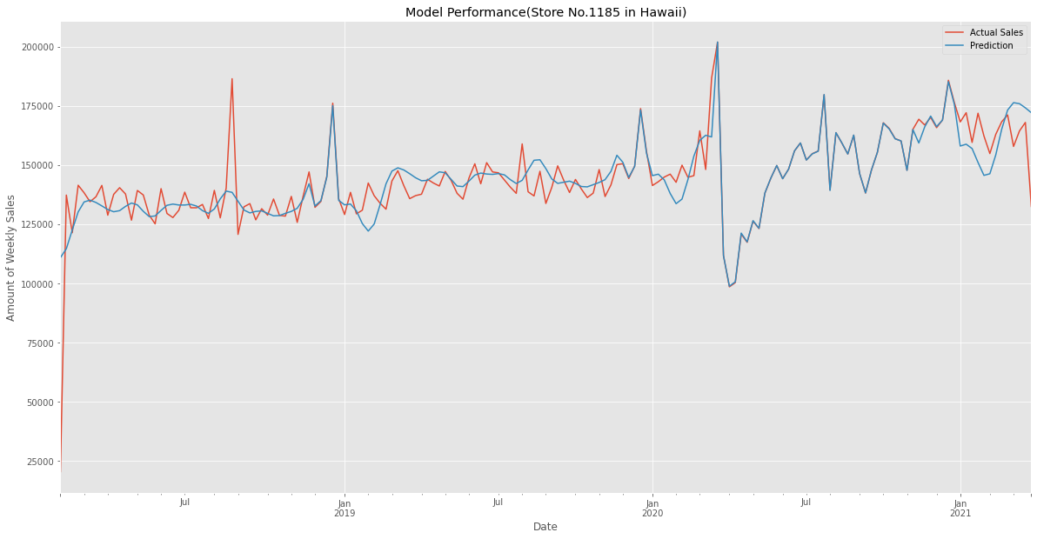
Pet Care Centers : Store1185
Prophet Model Performance on Weekly Revenue
(AVG sales:$144201.06; RMSE on testing set : 11804.88)
Author (Year). Title of the publication. Publisher
Author (Year). Title of the publication. Publisher
Author (Year). Title of the publication. Publisher
Author (Year). Title of the publication. Publisher
Author (Year). Title of the publication. Publisher
Author (Year). Title of the publication. Publisher
Author (Year). Title of the publication. Publisher
Author (Year). Title of the publication. Publisher
test

Slide 25
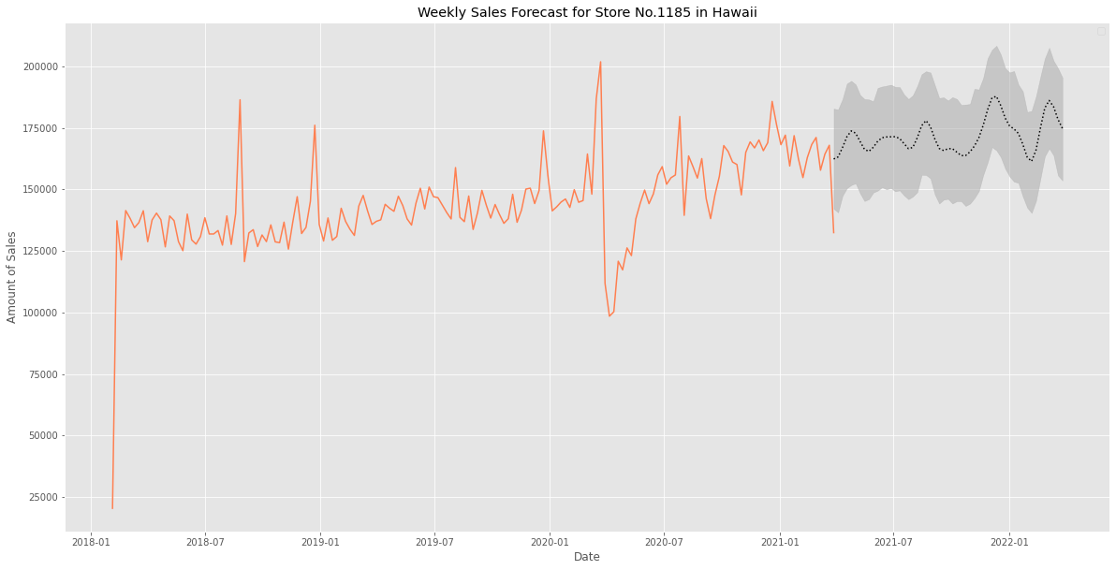
Pet Care Centers : Store1185
Prophet Model Prediction on Weekly Revenue
Author (Year). Title of the publication. Publisher
Author (Year). Title of the publication. Publisher
Author (Year). Title of the publication. Publisher
Author (Year). Title of the publication. Publisher
Author (Year). Title of the publication. Publisher
Author (Year). Title of the publication. Publisher
Author (Year). Title of the publication. Publisher
Author (Year). Title of the publication. Publisher

Slide 26
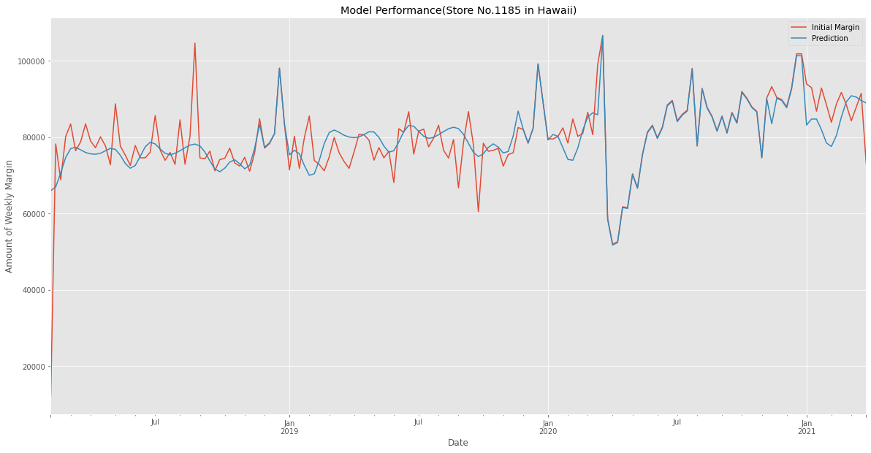
Pet Care Centers : Store1185
Prophet Model Performance on Weekly Margin
(AVG margin: $79962; RMSE on testing set : 7140.77)
Author (Year). Title of the publication. Publisher
Author (Year). Title of the publication. Publisher
Author (Year). Title of the publication. Publisher
Author (Year). Title of the publication. Publisher
Author (Year). Title of the publication. Publisher
Author (Year). Title of the publication. Publisher
Author (Year). Title of the publication. Publisher
Author (Year). Title of the publication. Publisher
test

Slide 27
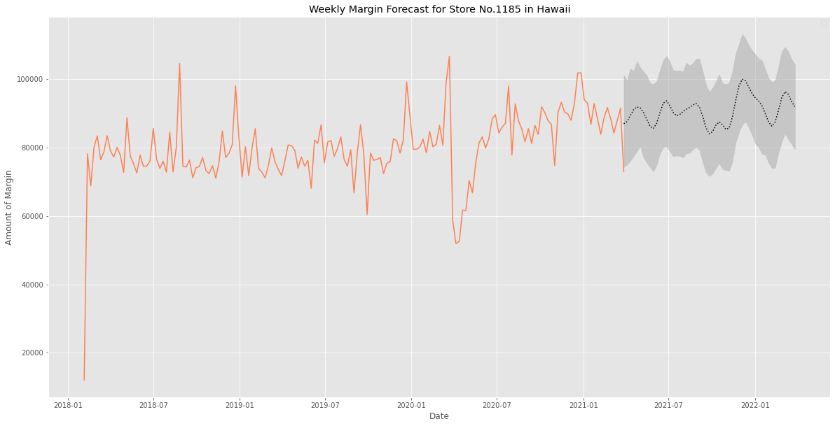
Pet Care Centers : Store1185
Prophet Model Prediction on Weekly Margin
Author (Year). Title of the publication. Publisher
Author (Year). Title of the publication. Publisher
Author (Year). Title of the publication. Publisher
Author (Year). Title of the publication. Publisher
Author (Year). Title of the publication. Publisher
Author (Year). Title of the publication. Publisher
Author (Year). Title of the publication. Publisher
Author (Year). Title of the publication. Publisher

Slide 28
Conclusions
01
02
Forecasting model
Prophet model works well with relatively small RMSE values on test sets
Considering seasonality and holiday (Covid19 and “new normal” also included) effects improves the performance
Margins are harder to predict accurately, forecasting by week gives better results
Future work
EDA on other features to figure out potential predictors
Try multi-variable time series model
Implement deep learning techniques, such as LSTM

Slide 29
Insights
01
02
Promotions for Vaccination Service
Prediction result on vaccinations shows an upward trend
Possible reason: COVID-19 drives increase in adoption
Develop different marketing strategies based on stores in different regions
E.g. prediction results of Store778 in Manhattan (downward trend) and Store1185 in Hawaii (upward trend)

Slide 30
Reference
[Time-Series Decomposition]
https://otexts.com/fpp2/decomposition.html
https://nwfsc-timeseries.github.io/atsa-labs/sec-tslab-decomposition-of-time-series.html
[ARIMA]
https://otexts.com/fpp2/seasonal-arima.html
https://www.analyticsvidhya.com/blog/2020/10/how-to-create-an-arima-model-for-time-series-forecasting-in-python/
[Prophet]
https://facebook.github.io/prophet/docs/quick_start.html

Slide 31

Thank You for Listening
Do you have any questions?
Yating Zhou(yaz041@ucsd.edu)
Chen Li (chl055@ucsd.edu)

